Slide 1


School Management System

Slide 2
Main Goal
The purpose of our web application is to make easier for admin to manage their human resources within the school system so we designed an app where you can :
Login to you account
Manage Users (Teachers and Students)
Manage Classes
Manage Courses
Manage Departments

Slide 3
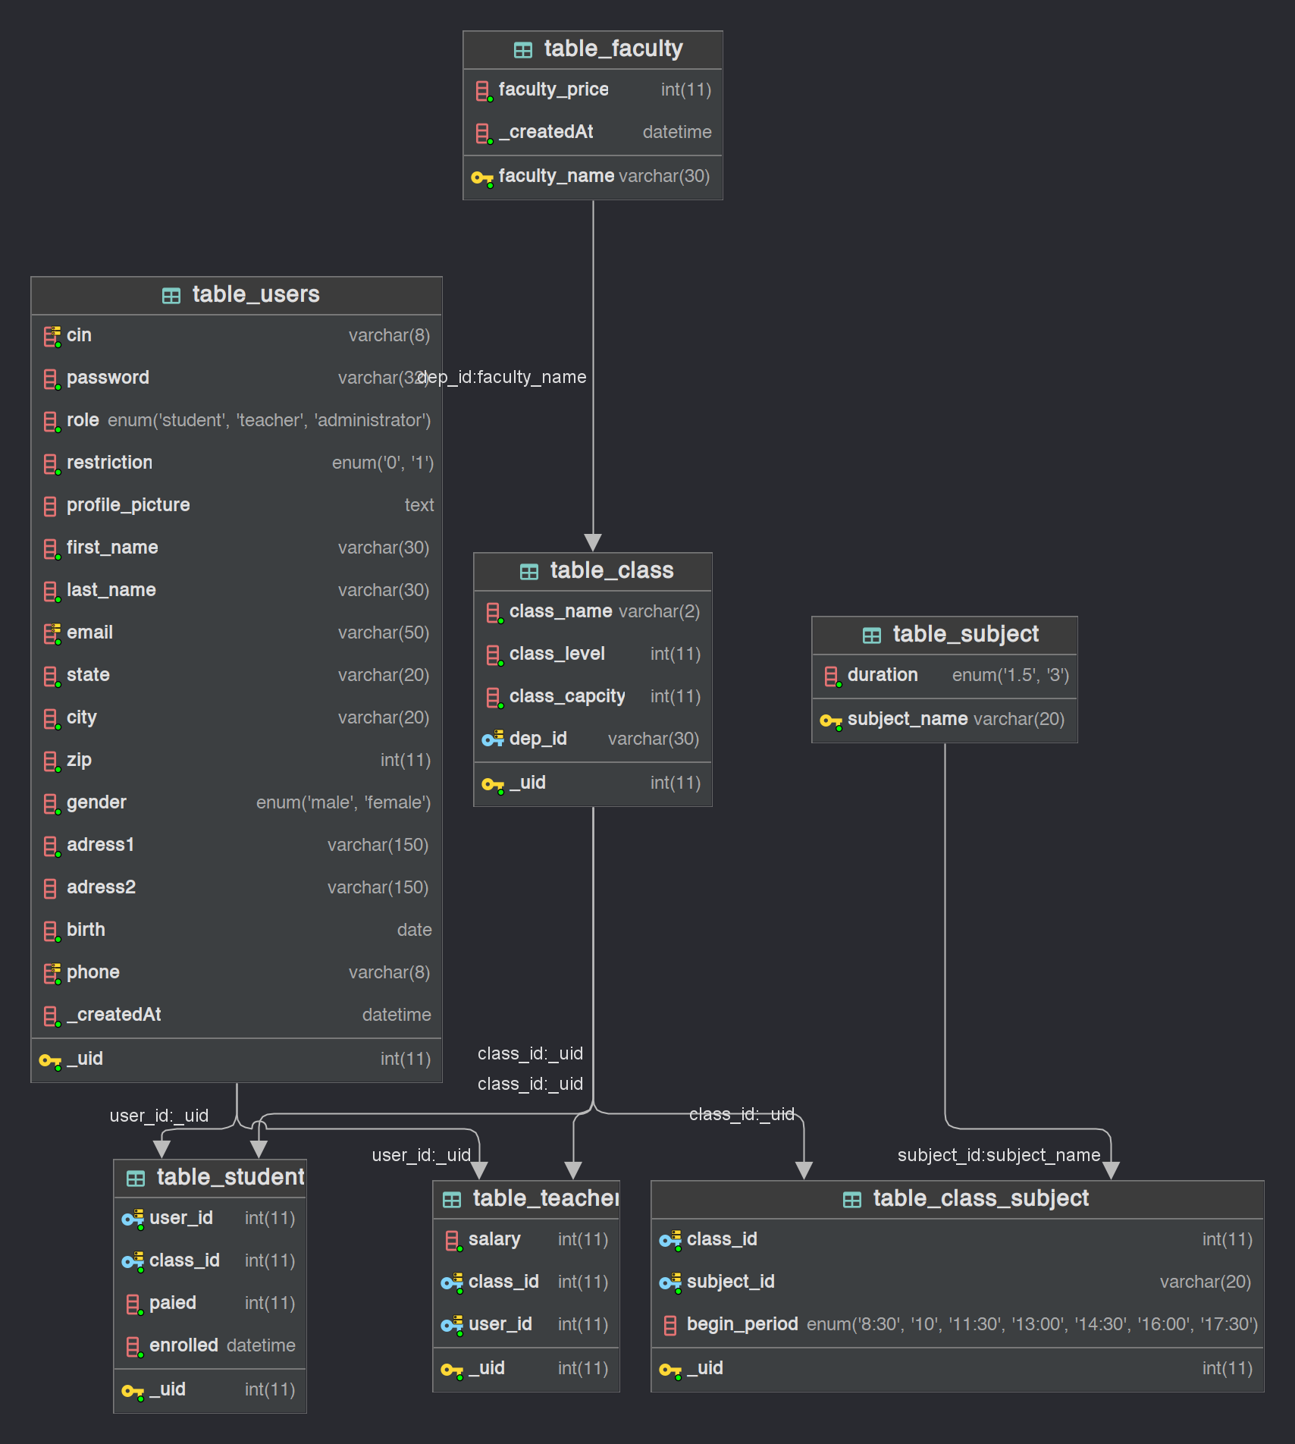
Our application have 7 classes connected with each other by unique keys to specify the flow of data and how these classes will interact with each others.
From this diagram in table users in role field we can reach a conclusion that our application will have 3 main actors which are Student, Teacher and Administrator.
Student and teacher will inherit from the same class ‘users’ and respectively will have additional information the them, and they will be able the see their information and update it.
An administrator can add teacher, student or another admin like himself, he can also manage classes, departments, subjects
Once an account is created is it disabled by default, so other users can’t exploit when they are not given access,
Access will be given when an admin assign a teacher to a class that he will be teaching or a student that joined a new class, An admin account will be always restricted.
A student can attend on class only at a time and each class will have different subject that are listed to it.
A teacher is able to teach only one class at a time.

Slide 4
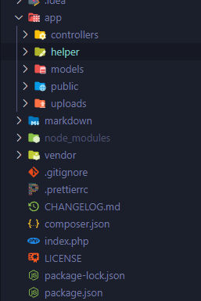
For this application we used the model-view-controller approach or in short MVC to give us easy and clear control over our code and make development faster.
We also used object-oriented programming to break code into small sized modules that can be coded fast and be solved easily.
We used PHP 8 as our backend technology, tailwind as our styling helper and alpine-Js to manage some interaction within our application.
We used an instance of PDO class, since PDO is a database access layer that provides uniform interface for working with databases and simplifies the common database operations like connection.

Slide 5
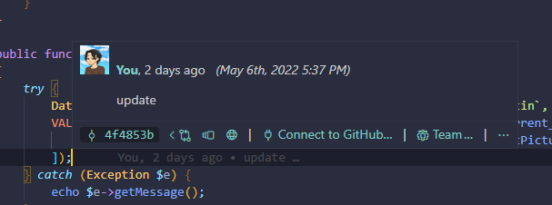
As it look in order to well write our code, we used a version control tool which is Git, this allowed us to focus on that task at hand for our code and progress in the code in a clean way.

Slide 6
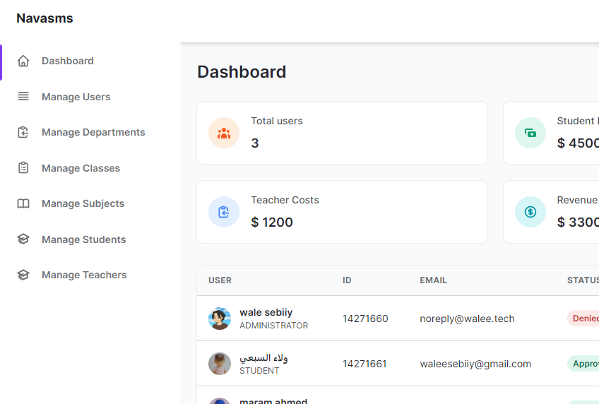
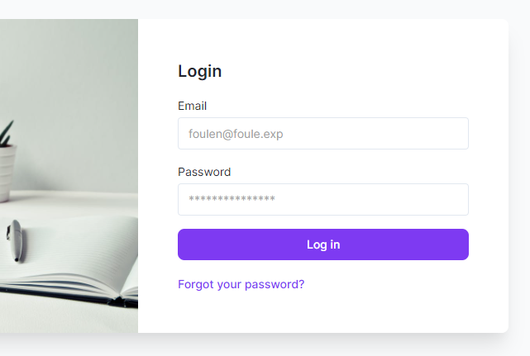
We can access my localhost ‘walee.test’ to see a more interactive scenario and get a feel of our application.

Slide 7
Thank You

